Slide 1
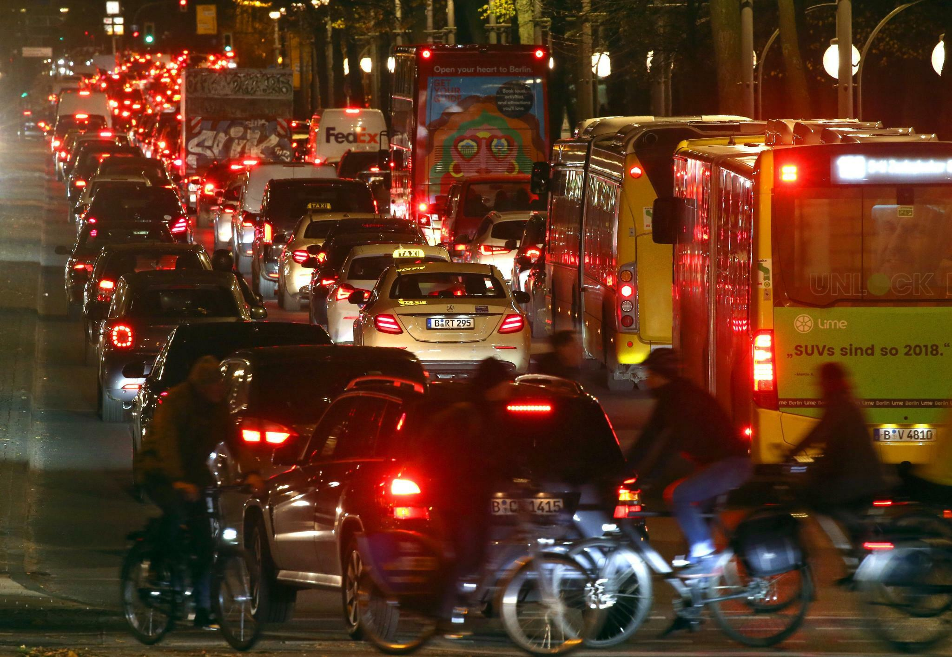
Traffic accidents with a focus on cyclists
With data from Berlin of the year 2020

Slide 2
How to prevent the number of fatal traffic accidents?
Finding the common ground for the most accidents
resulting in serious injury or death of cyclists
in order to potentially optimize the traffic infrastructure

Slide 3
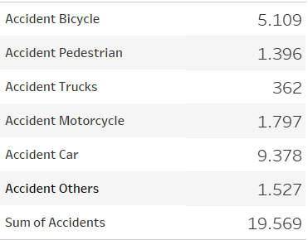
Overview 2020 in Berlin
ca. 1,073 billion motor vehicles

Slide 4
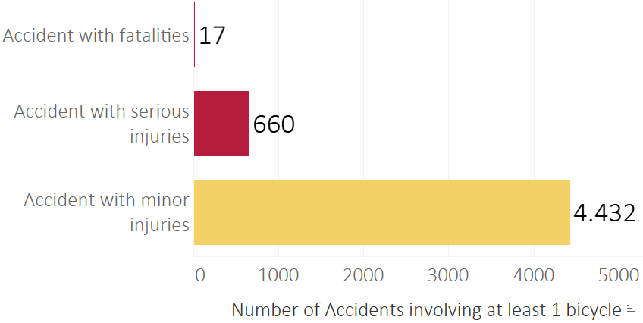
Accident Categories

Slide 5
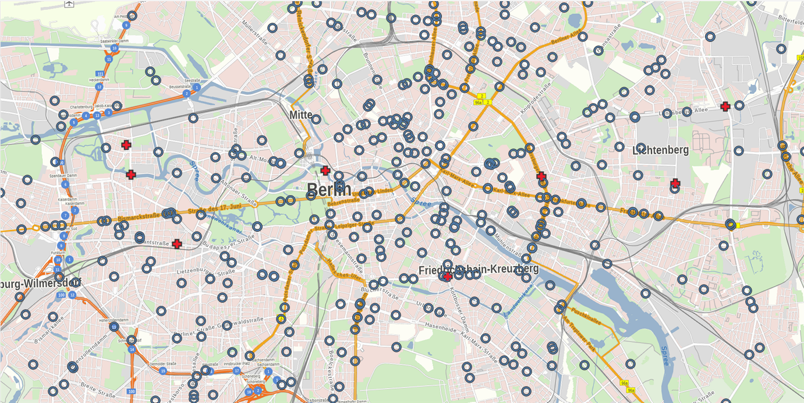
Accident Categories
Where did these accidents happen?

Slide 6
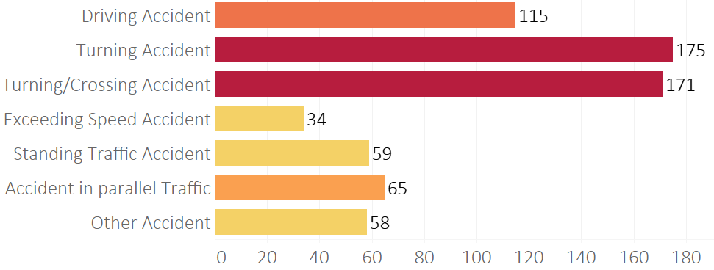
How did these accidents happen?

Slide 7
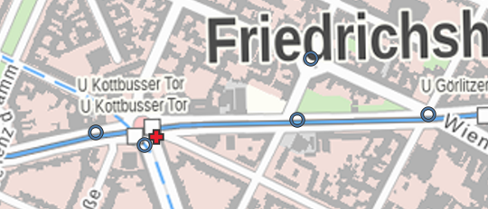
A closer look

Slide 8
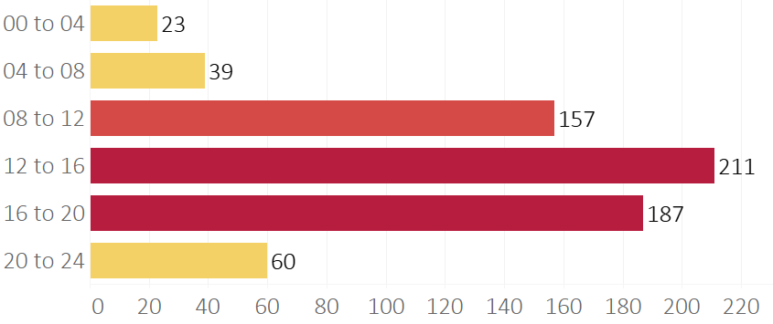
When did these accidents happen?

Slide 9
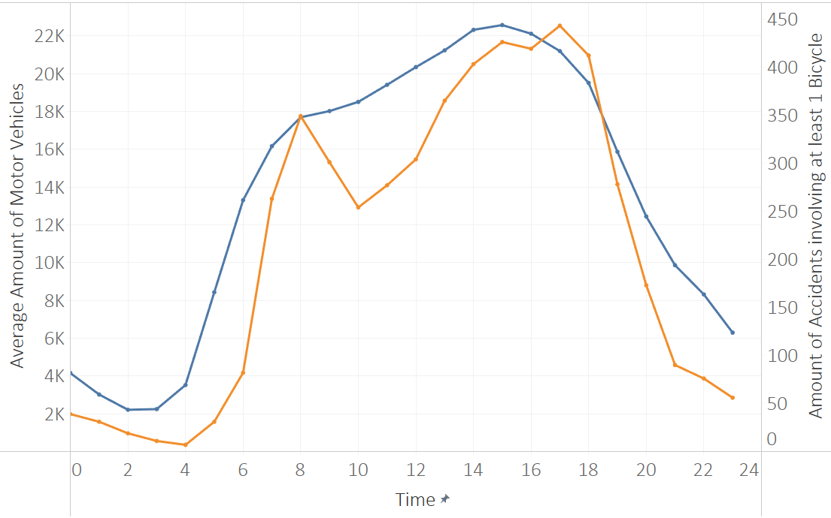
When did these accidents happen?

Slide 10
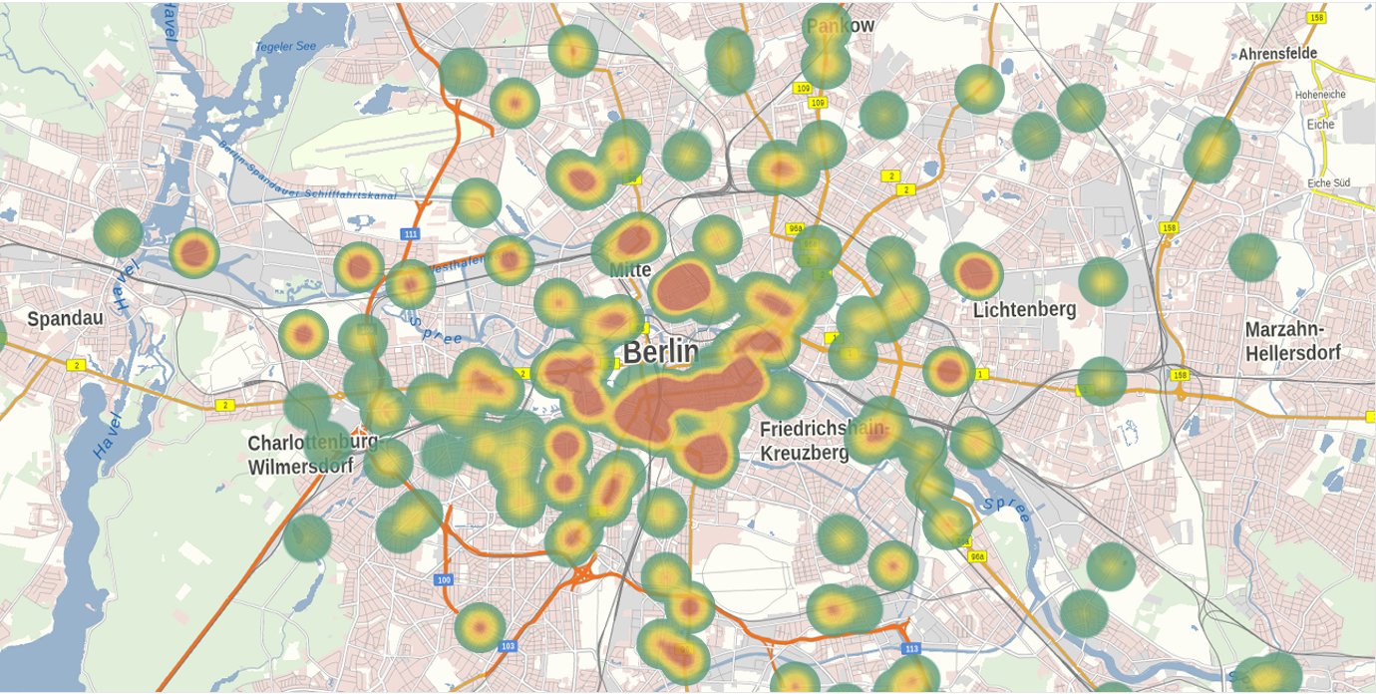
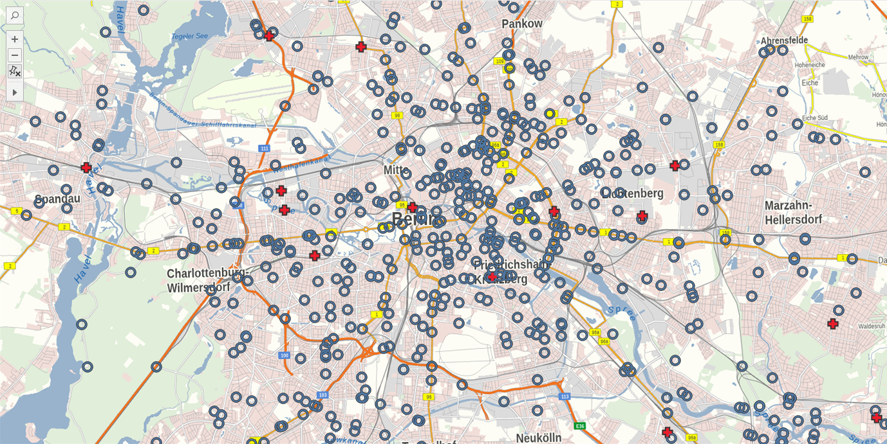

Slide 11
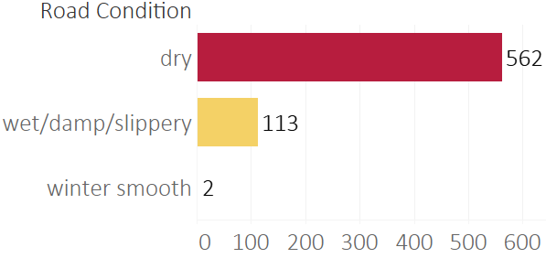
Other influences: Road Conditions

Slide 12
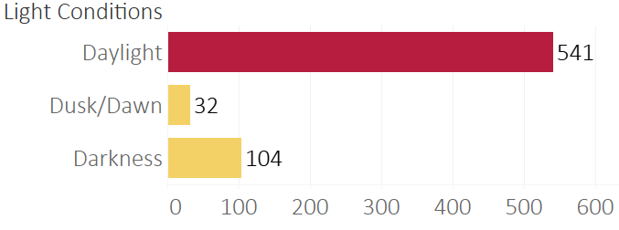
Other influences: Light Conditions

Slide 13
What have we learned so far?
accidents depend on the total volume of traffic
good conditions encourage careless behavior
most accidents happen when turning and crossing

Slide 14
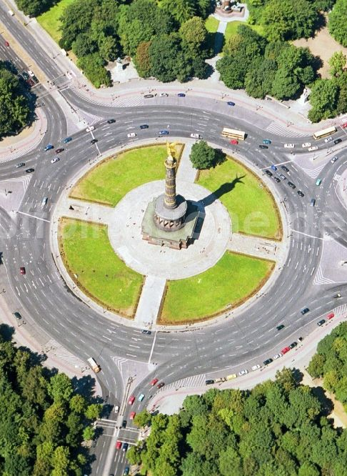
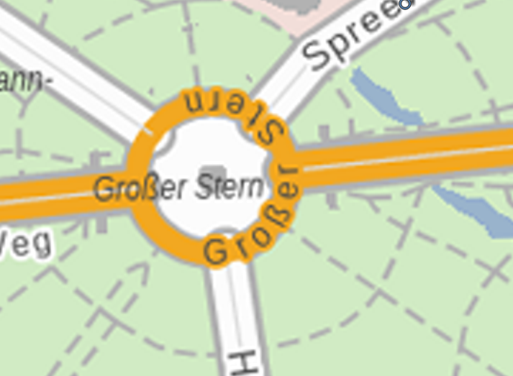
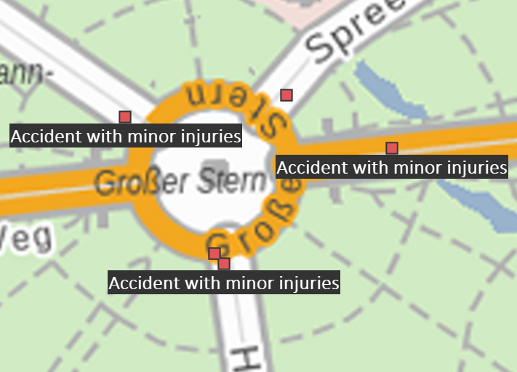
Countermeasures
replace road crossings with roundabouts
drive less and use public transport instead

Slide 15
Countermeasures
replace road crossings with roundabouts
drive less and use public transport instead
drive careful also if conditions are great

Slide 16
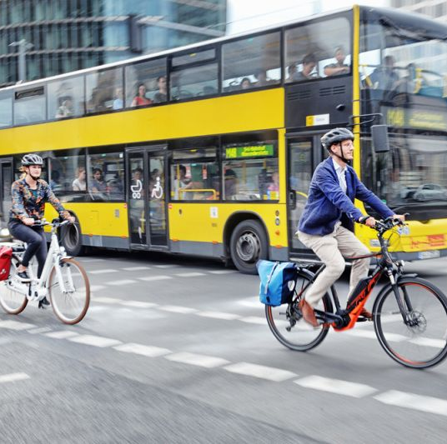
Thank you for your attention
Simon

